Slide 1
Tractor and Trailer Operations
P&O Ferrymasters
Driver Training Programme 2019 v1

Slide 2
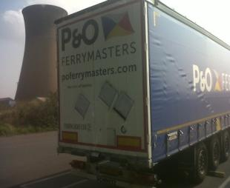
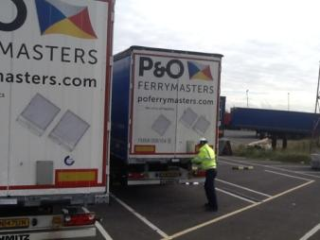
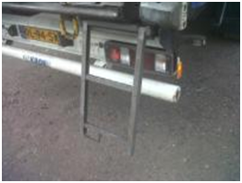
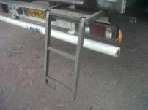
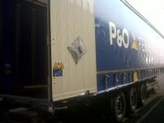
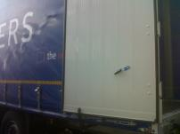
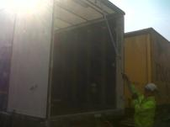
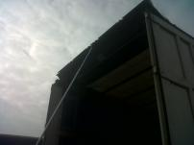
SWP002 - Opening a Sliding Roof - 1
Notes:
Opening a sliding roof . . .so the key steps . . .
1) Make sure Trailer steps are out correctly
2) Doors are fastened back with levers – don’t want them blowing open or swinging, as this can distort the trailer structure.
3) Roof pole is used – fundamental piece of equipment for a driver working with sliding roofs. Have it and use it, and use it correctly

Slide 3
Pulling on the roof cord…

Slide 4
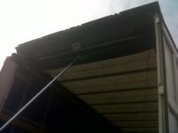
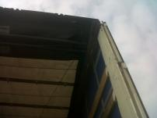
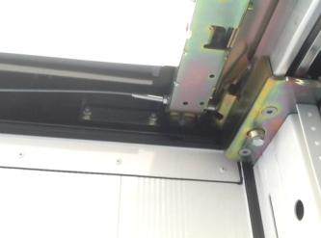
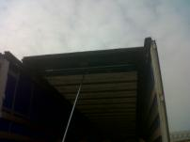
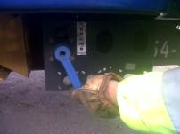
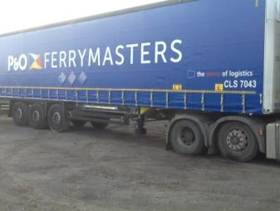
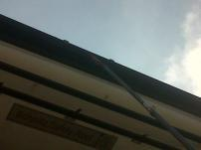
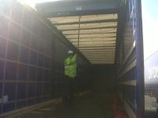
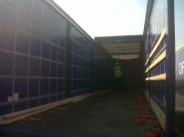
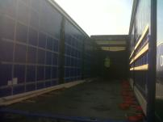
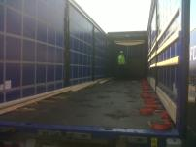
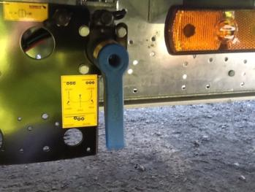
SWP002 - Opening a Sliding Roof - 2
Notes:
Opening a sliding roof . . .so the key steps . . .
1) Make sure Trailer steps are out correctly
2) Doors are fastened back with levers – don’t want them blowing open or swinging, as this can distort the trailer structure.
3) Roof pole is used – fundamental piece of equipment for a driver working with sliding roofs. Have it and use it, and use it correctly

Slide 5
Opening a sliding roof from Inside

Slide 6
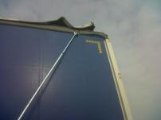
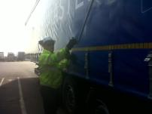
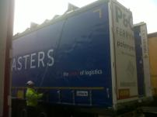
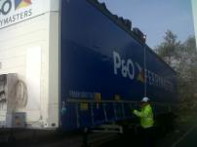
SWP002 - Opening a sliding roof from the ground

Slide 7
Opening a sliding roof from the ground

Slide 8
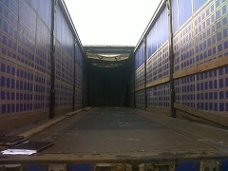
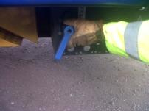
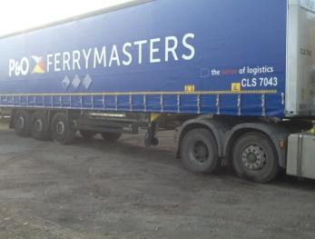
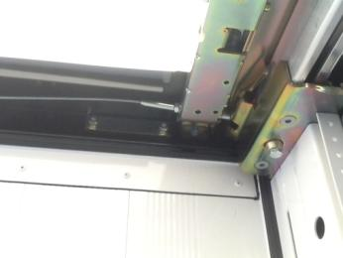
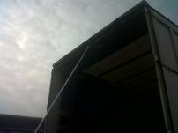
Closing a Sliding Roof – from inside the trailer

Slide 9
Closing a sliding roof from inside

Slide 10
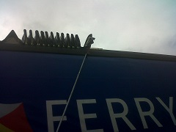
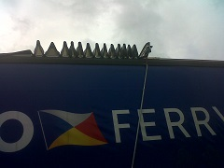
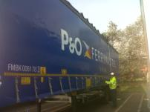
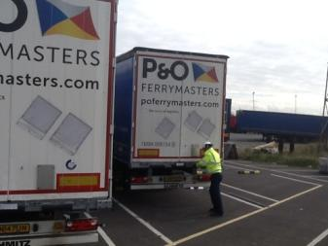
Closing a sliding roof from the ground
SWP002 - Closing a sliding roof from the ground

Slide 11
Opening a sliding roof from the ground

Slide 12
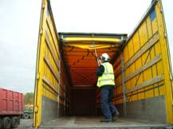
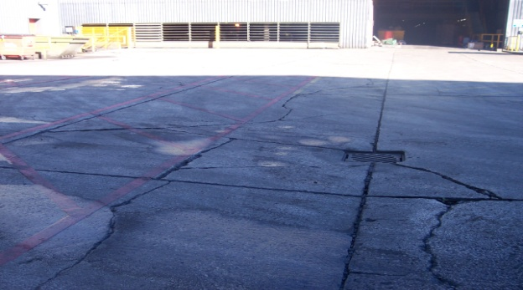
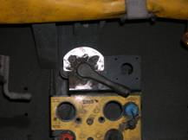
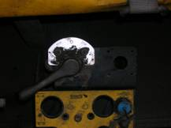
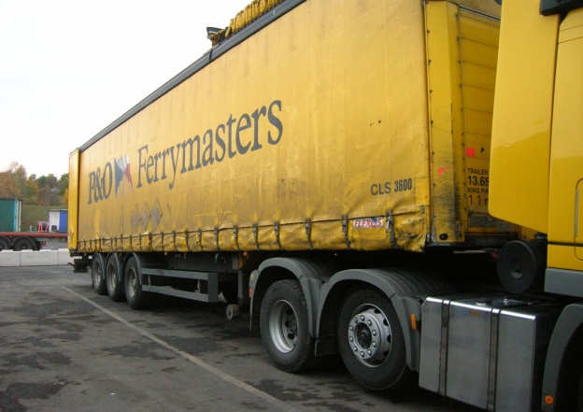
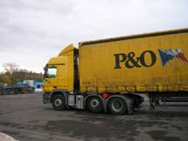
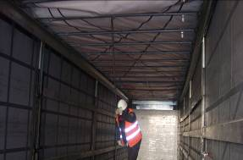
Visual Fault Finding – Sliding Roof
Problem Cause Solution
1.Heavy pushing on Opening/Closing 1. Sloping/uneven ground 1. Pull on to level ground
2. 5th Wheel High/Low 2. Inflate/deflate air suspension
Notes:
So the roof is difficult to push open / closed
Common causes
Is the trailer sloping
Is the trailer parked on uneven ground
Solutions
Move the trailer to level ground
Use the air suspension to level the trailer or slope the trailer to assist you.

Slide 13
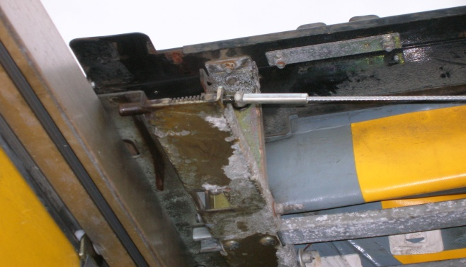
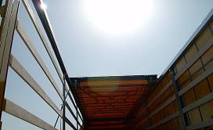
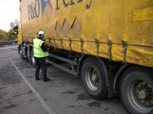
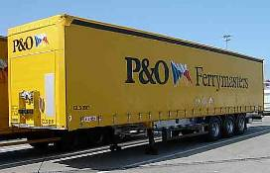
Visual Fault Finding – Sliding Roof
Problem Cause Solution
Roof Sticks or Jams and/or unable 1. Twist in trailer frame 1. Pull forward to align body
to disengage locking pins 2. Uneven Ground 2. Release curtain tension 3. Curtains closed and tensioned
Notes:
The roof jams or you are unable to disengage the locking pins
Common causes
Is the trailer twisted?
Is the trailer parked on uneven ground
Are the curtains closed and under tension?
Solutions
Move the trailer to level ground
Release the tension in the curtains

Slide 14
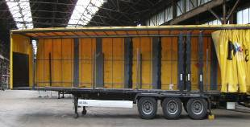
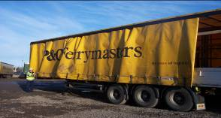
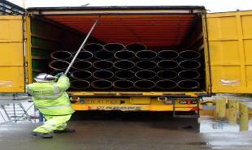
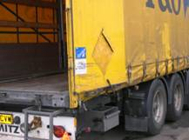
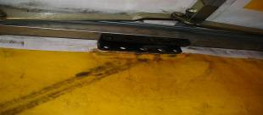
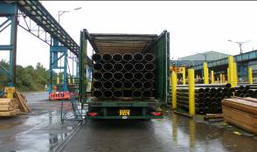
Visual Fault Finding – Sliding Roof
Problem Cause Solution
Roof Sticks or Jams and/or unable 1. One or both curtains open 1. Draw curtains closed
to disengage locking pins 2. Barn doors open 2. Secure rear doors 3. Sticky or dirty tracks or runners 3. Re-align roof with opposite side
Notes:
The roof jams or you are unable to disengage the locking pins
Common causes
Is one or both curtains open?
Are the doors open or hanging open?
Is the track for the roof runners clear?
Solutions
Draw curtains closed
Secure the rear doors
By doing these try and re-align the roof

Slide 15
If they don’t work then defect the trailer
Notes:
If none of the above work then defect the trailer . . .we don’t want climbing

