Slide 1
Tractor and Trailer Operations
P&O Ferrymasters
Driver Training Programme 2019 v1

Slide 2
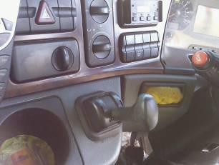
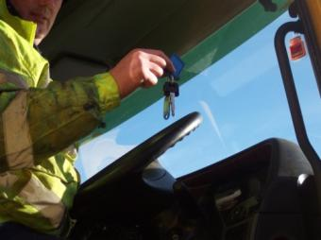
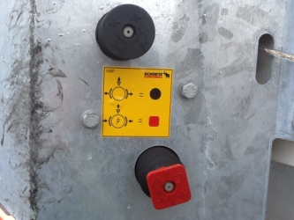
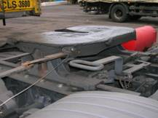
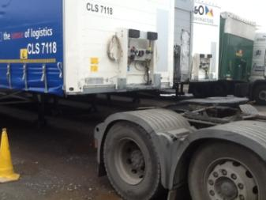
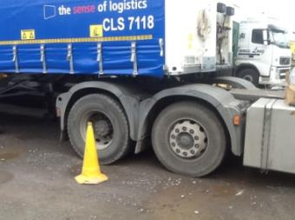
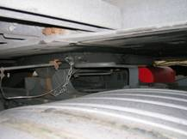
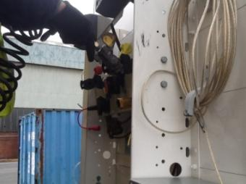
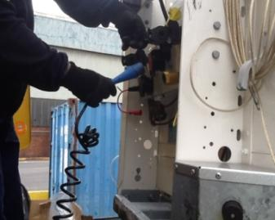
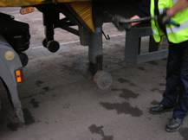
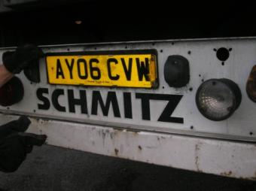





Coupling
SWP003 - Coupling

Slide 3

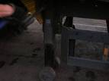

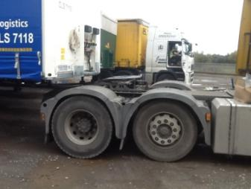
Uncoupling
SWP003 - Uncoupling

Slide 4
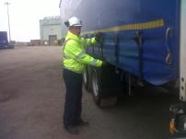
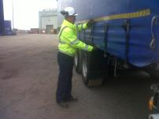
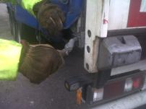
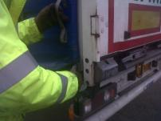
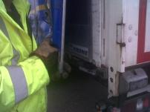

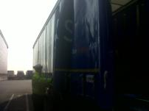
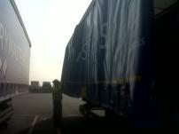


Opening and Closing side curtain
SWP004 Opening and Closing the Side Curtain

Slide 5
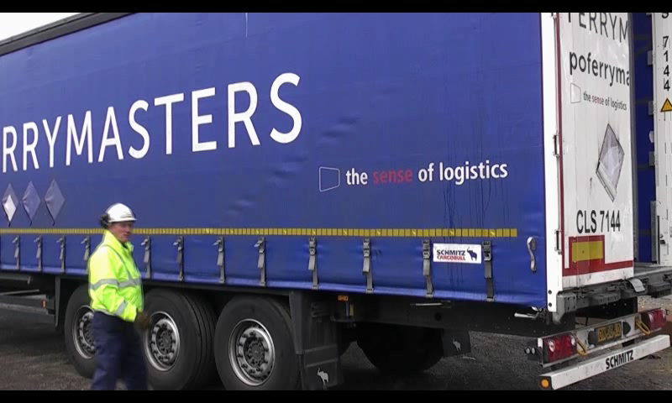
Opening and Closing side curtain

Slide 6
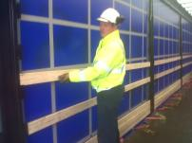
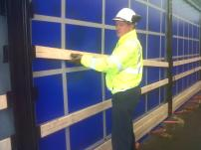
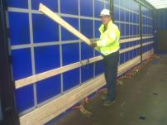
Removing sideboards
SWP005 Removing Sideboards

Slide 7
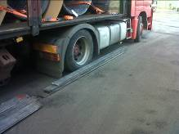
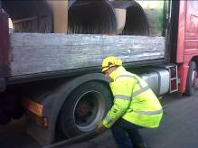
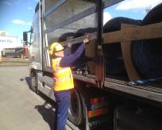
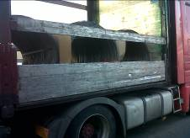
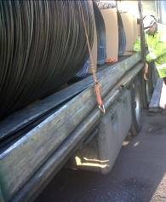
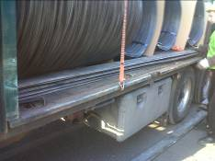
Replacing sideboards from the ground
Fig. 2
Fig. 3
Fig. 1
Fig. 6
Fig. 4
SWP005A - Replacing Sideboards from the ground
Notes:
With the trailer side boards placed ready for replacing back into trailer, carefully lift using both hands and bending knees ready to put into place
Holding sideboard with both hands, place one side into slot. Lift opposite side above its slot, support weight of board with other hand, place other side into opposite slot and repeat
Only replace boards to as far as can reach. Do not overstretch or climb on trailer wheels to put higher boards back
Any spare boards which are left over, place on side of trailer

Slide 8
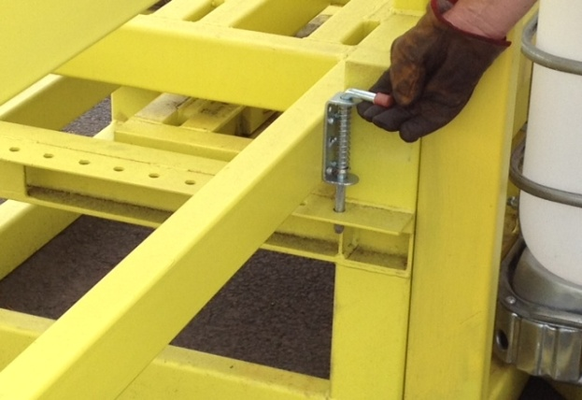
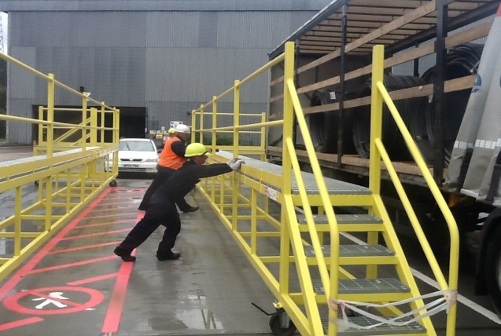
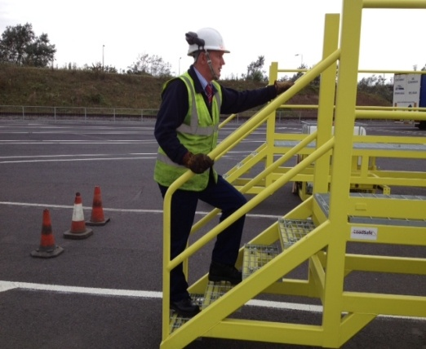
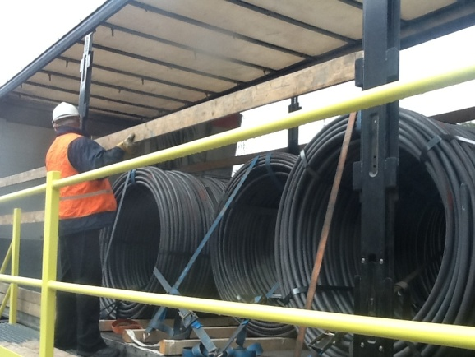
Replacing sideboards from a gantry
Fig. 2
Fig. 4
SWP005B - Replacing Sideboards from a Platform/Gantry
Notes:
Before use of small platform, a safety check must be completed, check for signs of damage, wheel brakes are in working order, wheels move freely. If any damage or wheel brakes not working, the platform MUST NOT be used. – Fig. 1
Positioning the platform against the trailer, the open side of the platform MUST be against the trailer at all times, once the platform is in the position you require, all wheel brakes must be applied, this can be done by pushing down on the lever above the wheel with your foot. – Fig. 2
Accessing the platform, you MUST wear your helmet chin strap before you access the platform. 3 points of contact must be used to access the platform via the steps, Once access has been gained, you must be aware of your position on the platform and work in the centre of the platform avoiding the 2 sets of access steps either side of the platform. – Fig. 3
Holding sideboard with both hands, place one side into slot. Lift opposite side above its slot, support weight of board with other hand, place other side into opposite slot and repeat. – Fig. 4

Slide 9
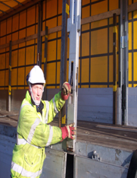
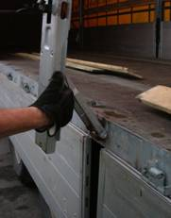
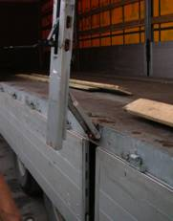
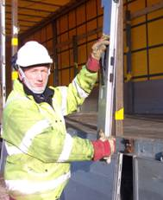
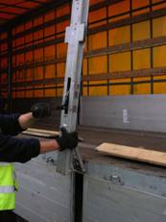
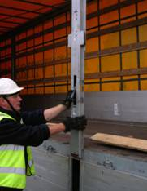
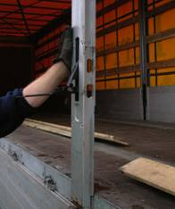
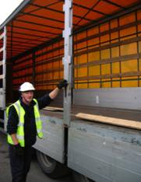
Fig. 1 Fig. 2 Fig. 3 Fig. 4
Fig. 5 Fig. 6 Fig. 7 Fig. 8
SWP007 - Removing and Replacing Sideposts
Notes:
Open curtain following
Remove sideboards
Remove Side gates
A trailer with 4 side posts, you can only have 2 removed at any time.
For a trailer with 2 side posts, you can only have 1 removed at any time.
Trailers with 3 side posts on each side, the centre post should not be moved more than third of the distance from the front or the rear
Stand to one side of the side post and pull down the handle, being careful to avoid spring back and catching or trapping fingers
Grasp the side post firmly and pull out the side post from the trailer bed, again avoiding trapping of fingers
When the post is free, then firmly grip the base of the post and support the middle of the post with your other arm. Ensure the post is firmly in its tracks. The post can be slid along the trailer
Replacing the side post. Position the foot of the side post into the designated slot
Standing to one side, keeping fingers clear, use the palm of your hand to push the post back into place.
Close the lever and ensure that the mechanism has locked the post firmly in place

Slide 10
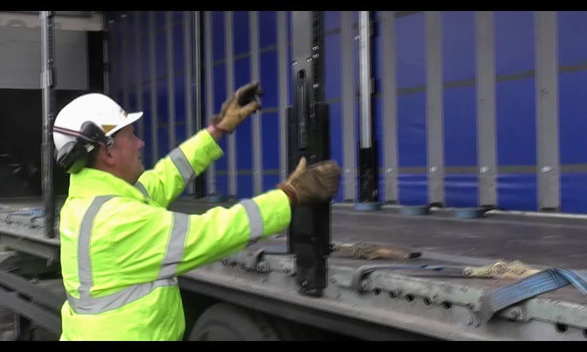
Removing and replacing side posts

Slide 11
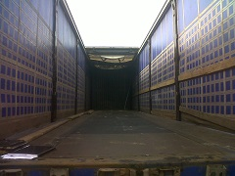
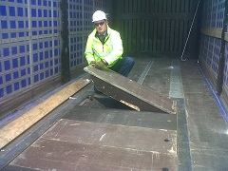
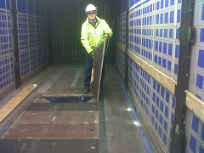
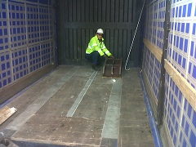
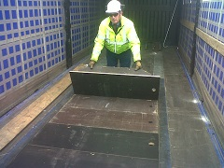
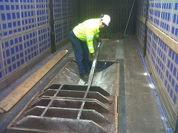
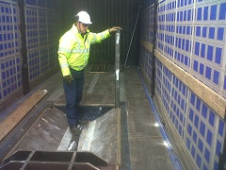



SWP008 - Preparing a Coil Well

Slide 12







Fig. 1 Fig. 2 Fig. 3
Fig. 4
Fig. 5 Fig. 6 Fig. 7
SWP009 – Load securing and ratchet operation
Notes:
Always try to work from the ground. Never go on the back of a load
Check condition of fixed strap prior to use to make sure there is no damage or tears.
If strap is found to be unusable, ensure this is reported via the Defect reporting procedure. Refer to procedure for using loose straps.
Check no one is present on the other side. Throw strap to next securing point.
Open ratchet and feed the strap into the ratchet, being careful not to cut or trap fingers. – Fig. 1 and 2.
Operate the ratchet to tension the strap, being careful not to over exert or cause back injury. Try not to strap above or below you but at chest height. – Fig. 3, 4 and 5.
Do not double loop excess strap back into ratchet
Leave remainder of strap neat and tidy rolled up next to ratchet.

Slide 13







SWP010 - Removing stanchion posts from the coil well

Slide 14






Removing Stanchion posts from stanchion holder
Fig. 2
Fig. 3
Fig. 1
Fig. 5
Fig. 6
SWP010A – Removing stanchion posts from stanchion holder
Notes:
Release catch on stanchion holder. – Fig. 1, 2 and 3.
With gloves on, placing two hands on stanchion, carefully lift out of stanchion holder, ensuring stanchion is evenly balanced - Fig. 4 and 5.
Place stanchion onto bed of trailer and slide on until fully on the bed of the trailer. – Fig. 6

Slide 15
Quiz

Slide 16


Quiz
Where can you get more information?
What can you check if the roof is difficult to open/close?
What are the first things to consider when coupling / uncoupling?
Should you push or pull when opening and closing a roof?
What should you do before opening and closing a roof from inside?
Uneven ground
5th Wheel height (too high / too low)
twisting in the trailer
Curtains – tensioned unevenly; open on one side; too much tension
Back doors hanging / swinging / uneven
Handbrake on
Engine off
Keys out
Trailer park brake on
www.poferrymasters.com/carrierinfo

