Slide 1
Tractor and Trailer Operations
P&O Ferrymasters
Driver Training Programme 2019 v1

Slide 2
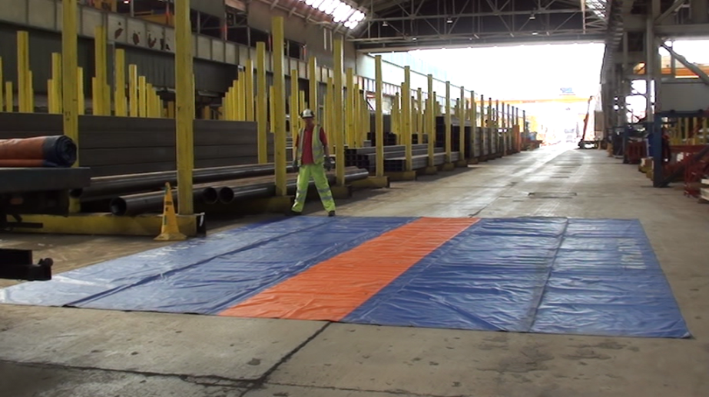
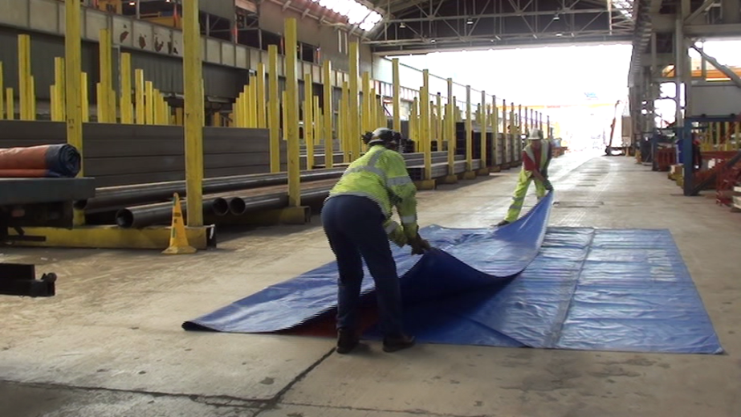
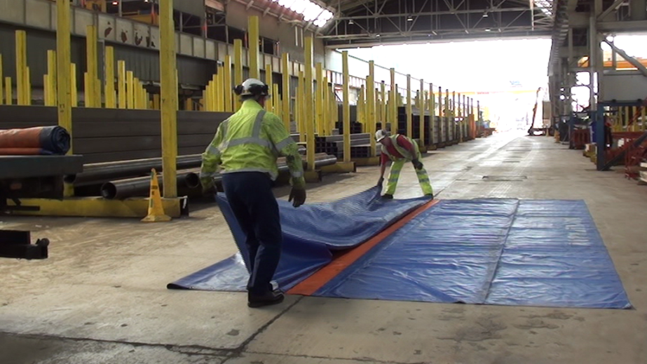
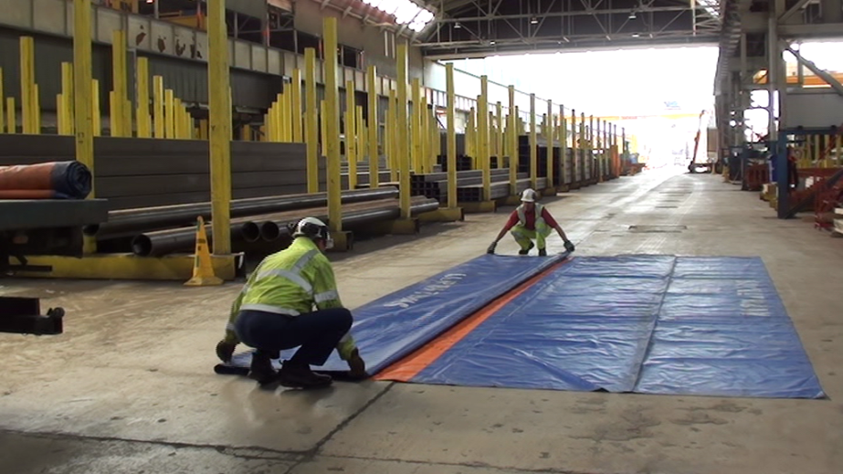
How to fold and roll a trailer sheet
1
2
Lay sheet out on floor
Take left side and fold 2/3rds over…
4
3
Then fold sheet back on itself
Make neat

Slide 3
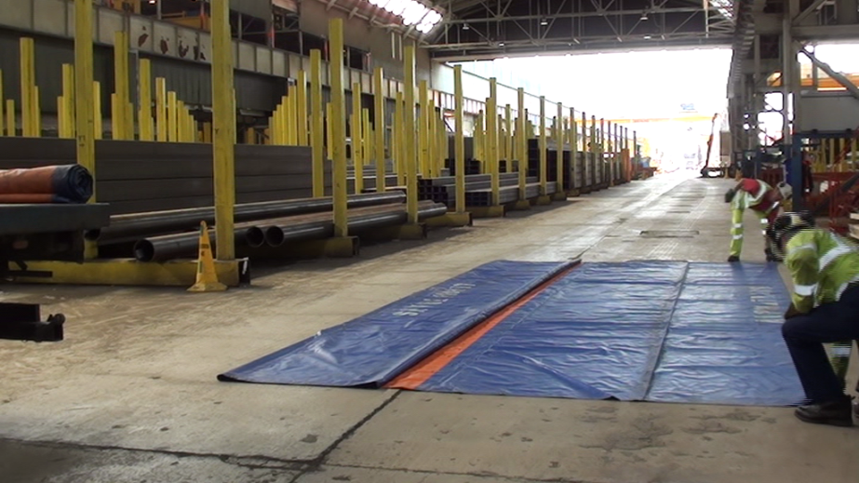
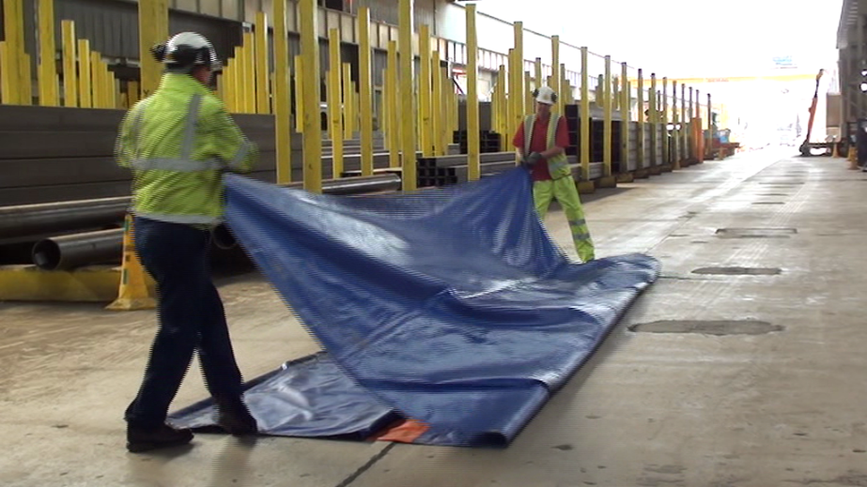
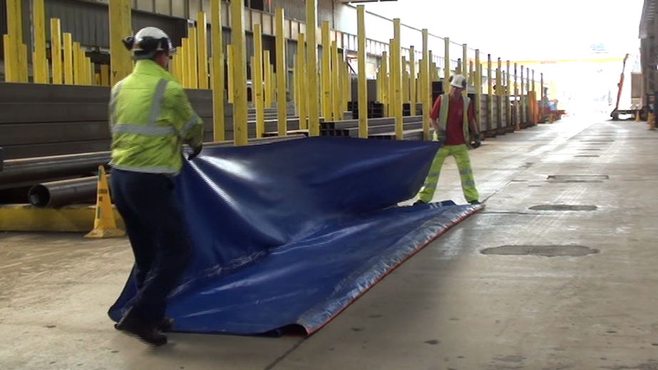
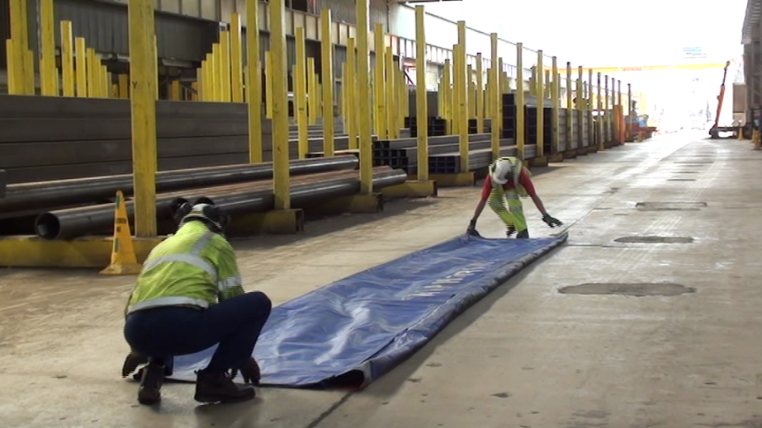
How to fold and roll a sheet
5
6
Take right side and fold over inwards…
Fold over the top of first folds…
7
8
Then fold sheet back over on itself.
Make neat.

Slide 4
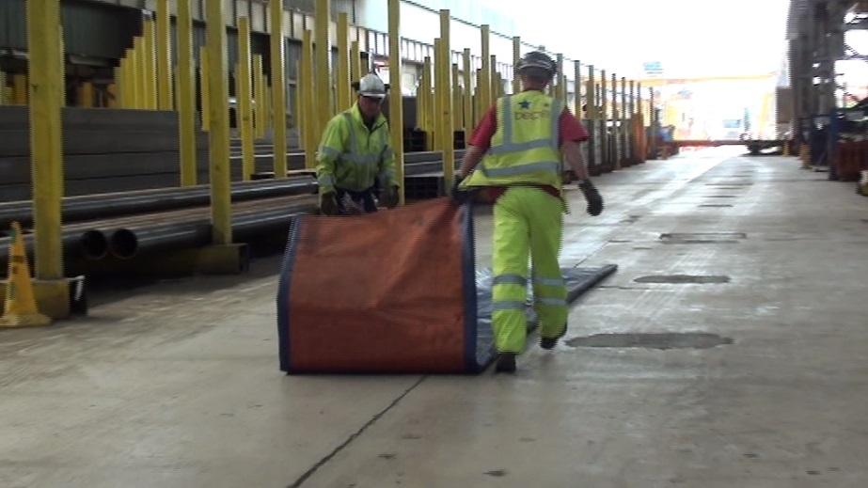
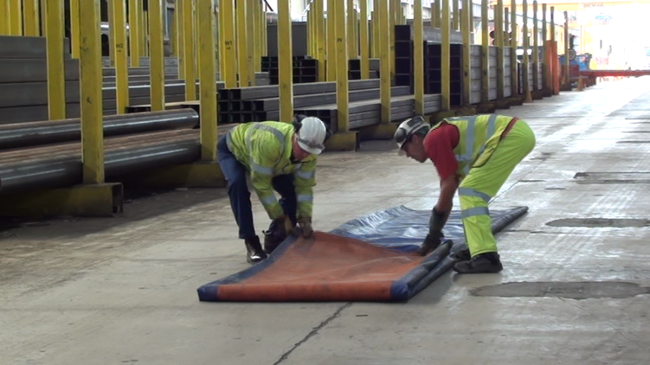
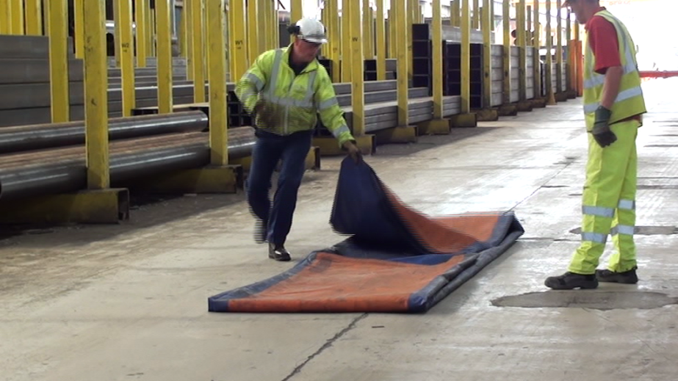
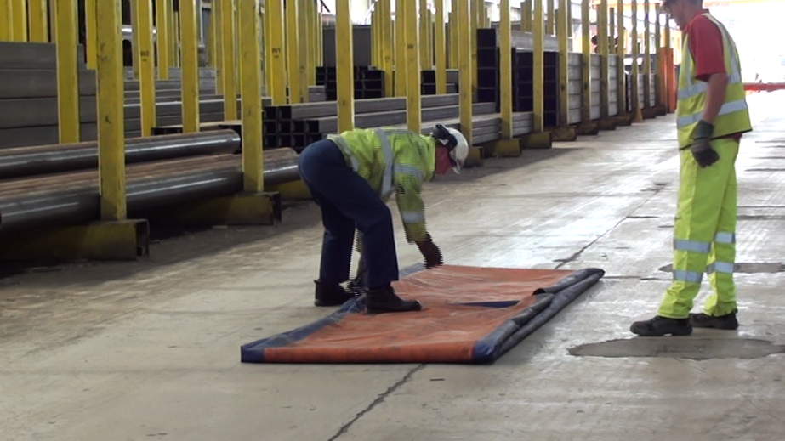
How to fold and roll a sheet
9
10
Take bottom end and fold into middle
Lay folded end flat
11
12
Take top end and fold into the middle
Make neat

Slide 5
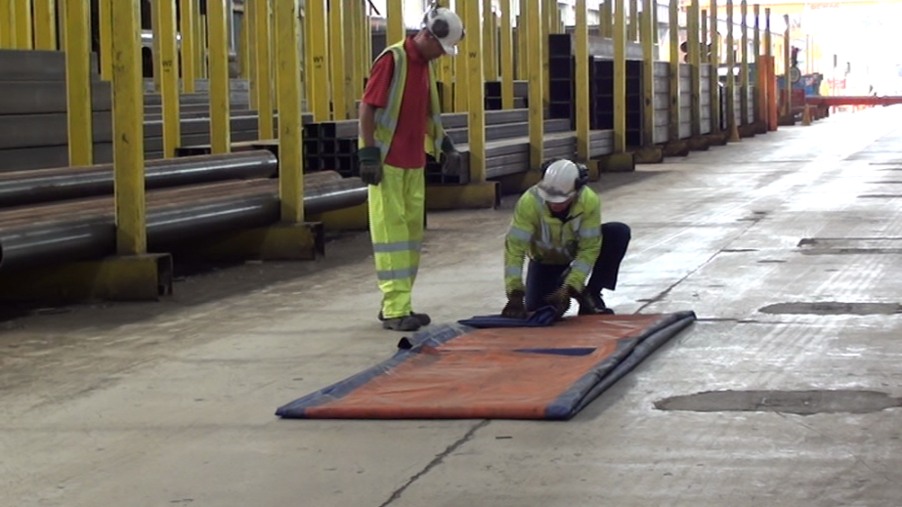
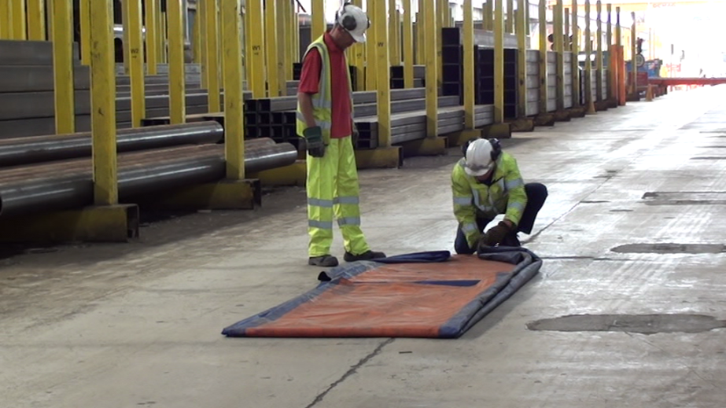
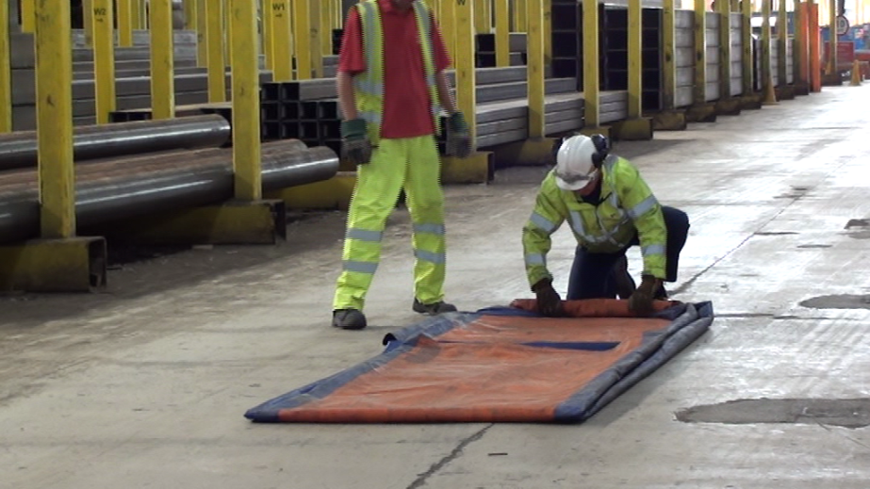
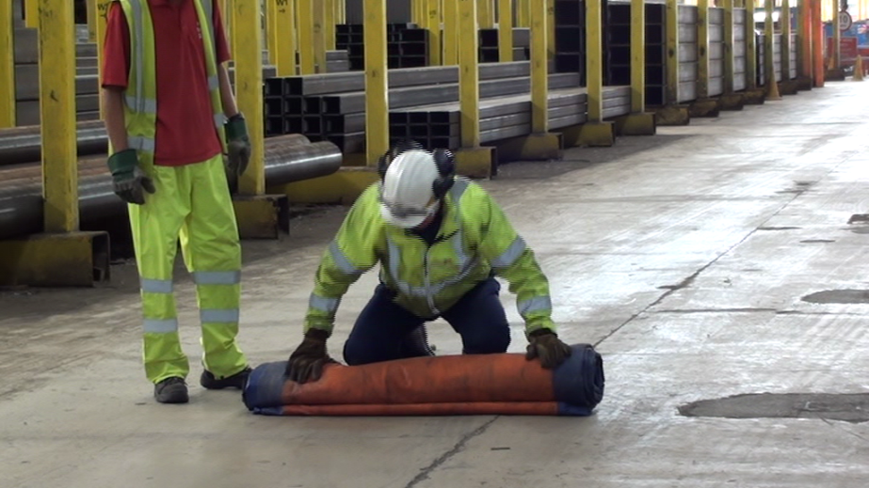
How to fold and roll a sheet
13
14
Fold top left corner inwards and push flat
Fold top right corner inwards and push flat
15
16
Take edge in both hands and roll keeping roll tight and neat…
Keep rolling tightly to the end.

Slide 6
How to fold and roll a sheet
Fold top left corner inwards and push flat
Fold top right corner inwards and push flat

Slide 7
And how not to……
Fold top left corner inwards and push flat
Fold top right corner inwards and push flat

