Slide 1
Axle Weights
P&O Ferrymasters
Driver Training Programme 2019 v1

Slide 2
Axle Weights - Issues
Overweight on the Tractor Unit Drive Axle
Overweight on the Trailer axle
The driver is responsible for the positioning of the load and
ensuring they are not overweight on their drive or trailer axle
The Customer also has a legal responsibility to assist the driver as far as reasonably practicable
Notes:
Axle weight infringements come in 2 forms. Tractor Unit drive axles and trailer axles. Although the loader places the load on the trailer. The driver has responsibility for the positioning of the load and ensuring that he is not overweight.

Slide 3
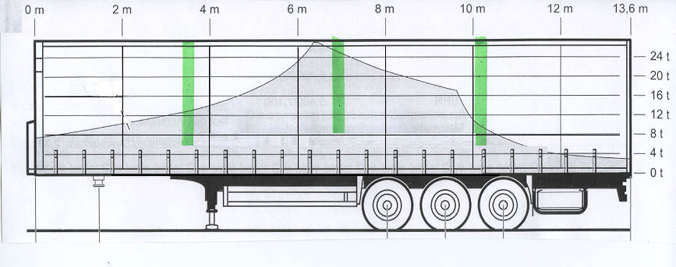
Axle Weights
8 ton
8 ton
8 ton
Notes:
Trailers commonly used on the European traffic are allowed to have 8 ton on each of the trailer axle.
An additional complication and consideration is the difference axle weight requirement for 2 and 3 axle tractor units. Although in the UK you may not have to worry about axle weights with 3 axle units, when on the continent, the trailer will always be collected by a 2 axle tractor unit, and the positioning of the load to comply with axle weights is key
When positioning loads the following generic guidance can be followed.

Slide 4
Axle Weights – Full Length Loads – 24 ton
Trailer’s Roof supports
12m
Centre of Gravity
Notes:
The centre of gravity of a trailer and thus the middles positioning of a load should be just in front of the first trailer axle. When positioning 12m length of uniform load, then the middle of this load should be where the centre of gravity of the trailer

Slide 5
Axle Weights – Part Length Loads – 24 ton
Trailer’s Roof supports
9m
Centre of Gravity
Notes:
9m length of load should similarly be placed in the middle of the trailer, balanced around the centre of gravity

Slide 6
Axle Weights – Part Length Loads – 24 ton
Trailer’s Roof supports
7m
Centre of Gravity
Notes:
7m length of load should similarly be placed in the middle of the trailer, balanced around the centre of gravity

Slide 7
Axle Weights – Part Length Loads – 24 ton
Trailer’s Roof supports
6m
Centre of Gravity
Notes:
6m length of load should similarly be placed in the middle of the trailer, balanced around the centre of gravity

Slide 8
Axle Weights – Mixed Length Loads – 24 ton
Trailer’s Roof supports
6m
7m
9m
12m
Centre of Gravity
Notes:
A combination of lengths of loads need to be loaded around the centre of gravity

Slide 9
Axle Weights – Single Coil Loads – 24 ton
Trailer’s Roof supports
Centre of Gravity
Notes:
In terms of steel coil. Single heavy coils should be positioned around the centre of the trailer, which is normally the second position back in the coil well

Slide 10
Axle Weights – Multiple Coil Loads – 24 ton
Trailer’s Roof supports
Centre of Gravity
Notes:
Multiple coils should be positioned around the centre of gravity, but spread along the coil well, in line with the stanchion positions

Slide 11
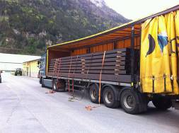
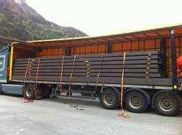
Axle Weights – Signs of overloading
Load not spread over the back axle
Road marks
Flat spots on the tyres
Vehicle struggling to pull away (having to use crawler gears)
Notes:
There are some obvious signs of overloading of axle weights. If your vehicle is overloaded on the drive axle then the load will not be spread over the back axles of the trailer. There may be marks on the road or flat spots on the tyres. The tractor unit will be noticeably more difficult to pull away

Slide 12
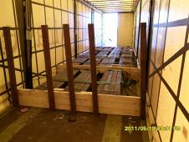
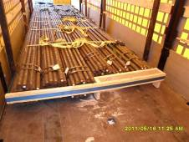
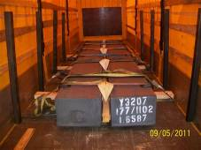
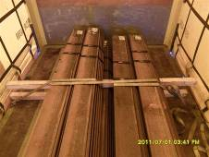
Axle Weights – Load Restraint
Achieving axle weights (stowing the load away from the headboard) can negatively impact on the ability to position the load blocked against the headboard. Additional restraints should be considered on shorter length loads:-
Is it possible to use stanchions to create a false headboard?
Can straps be used with timber to create a false headboard?
Are there any vertical gaps in the load?
Can strangle wraps be applied to bring the lengths together?
Notes:
So we have talked about axle weights and where some generic steel loads should be positioned. Unfortunately when you get one thing right, you can compromise another. In this case by loading around the centre of gravity you may create a space between the trailer headboard and the load. In the event that the load cannot be placed against the headboard then additional load restraint measures should be taken.
Can you use stanchions to block the load or create a false headboard?
Can straps and timbers be used to create a false headboard?
Are there any vertical gaps in the load that should be infilled. Once this is done, can you then strangle the bundles or sections together to pull the load in one unit, so if it does move forward the straps will strangle and grip it.

Slide 13
Axle Weights – Summary
Trailer’s Roof supports
6m
7m
9m
12m
Centre of Gravity
Notes:
Summary of load positioning and axle weights

